Slide 1
Azure Container Services from CloudShell of Azure
CodeSizzler

Slide 2
Step - 1: Login to the Azure Portal
Step - 2: Open the cloud shell from Azure using Linux (Bash) environment
Step - 3: Run the below commands now:

Slide 3
//Create a resource group on your azure account
$az group create —name ACI-test —location southeastasia

Slide 4
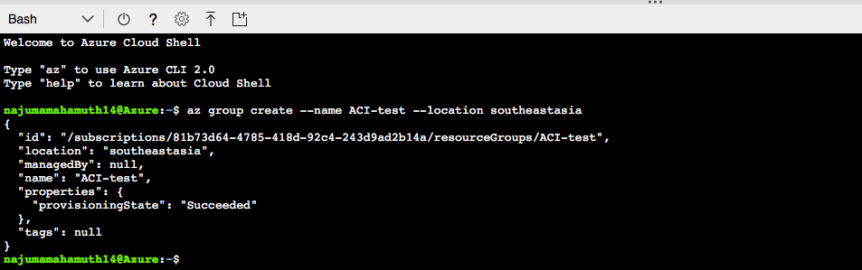

Slide 5
//Create a container on azure with pip
$az container create —name myfirstaci —image microsoft/ < aci-helloworld —resource-group aci-test

Slide 6
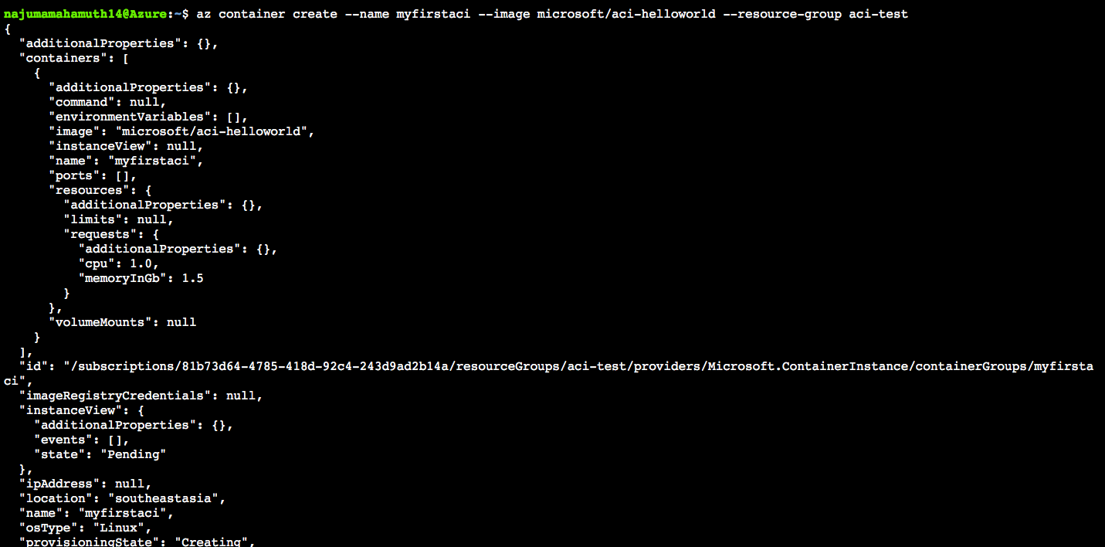

Slide 7
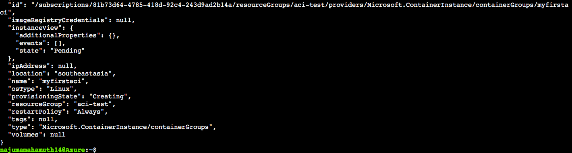

Slide 8
//Check the container status
$az container show —name myfirstaci —resource-group aci-test

Slide 9
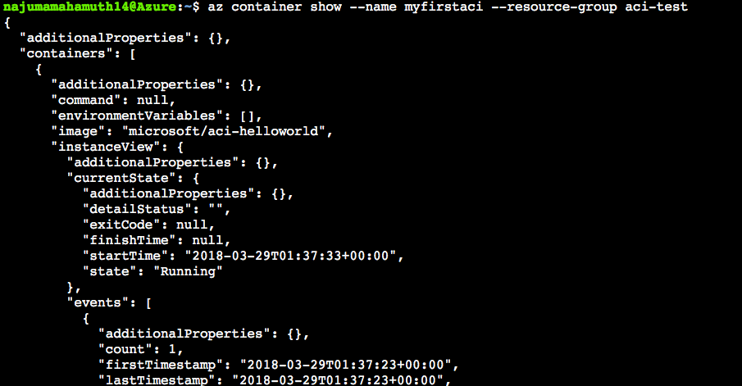

Slide 10
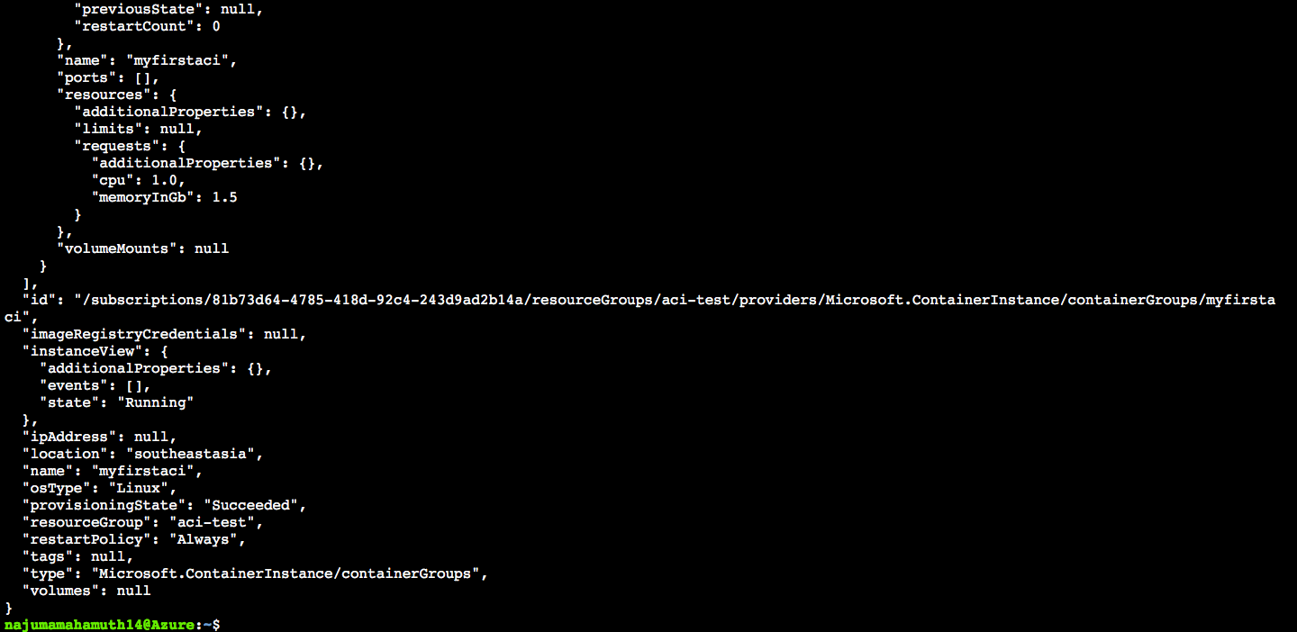

Slide 11
//Delete the container
$az container delete —name myfirstaci —resource-group aci-test

Slide 12
